Slide 1

Notes:
Well those were some interesting projects, stay tuned…. Let me go to an an amazing one!

Slide 2
Motivation :
In 21st century the Internet became a place where everyone can learn anything. The video tutorials are the most popular means of learning
Youtube is one of the most effective platforms where students and others prefer to learn a free course

Slide 3
?
Notes:
Here is a quick question: Can I have a show of hands if you ever learn something from youtube.
Okay, I can see a good number of hands!

Slide 4
Enthusiastic student:
Ever felt I wish I had a printed version of the notes for a video tutorial
Does it feel good if some summarizes one hour of lecture into a small paragraph which can be understood easily if you are in a hurry
Notes:
Well I have been doing the same! Soo..
Did you wish you had a printed version of the video tutorial ? And wont it feel good if someone summarizes the whole lecture in a small pa

Slide 5

We got you covered!
Notes:
If you are in the same boat. Don't worry, we got you covered!

Slide 6

AI audio content explorer!
Notes:
We are team Synopsis we will explain about out audio content explorer! This is solution to all our problems

Slide 7
THE PROBLEM IN THE CURRENT SOLUTION
Due to manual note taking process, the hassle of rewatching the tutorial and pausing it several times can be inaccurate and can be cumbersome at sometimes
A student spend hours to take notes by watching the same video tutorial again and again
Students spend a lot of time in summarizing what they have understood

Slide 8
Our Solution
We used an AI based NLP engine which takes a mp3 version of a video as input and gives us the the following key insights:
Entire text as a transcript to download
Summary of the text automatically grouped into chapters
Ranks highly important phrases
A smart word cloud of important words in text

Slide 9
Overview of Synopsis Architecture
Auto Chapter Summary
Sentiment Analysis
Input
NLP Engine
Phrase Highlights
Word Cloud
Notes:
Let me walk you through our project architecture
Our NLP engine consists of 4 important modules
At the core of our NLP lies an AI text analyzer called “Assembly AI”

Slide 10
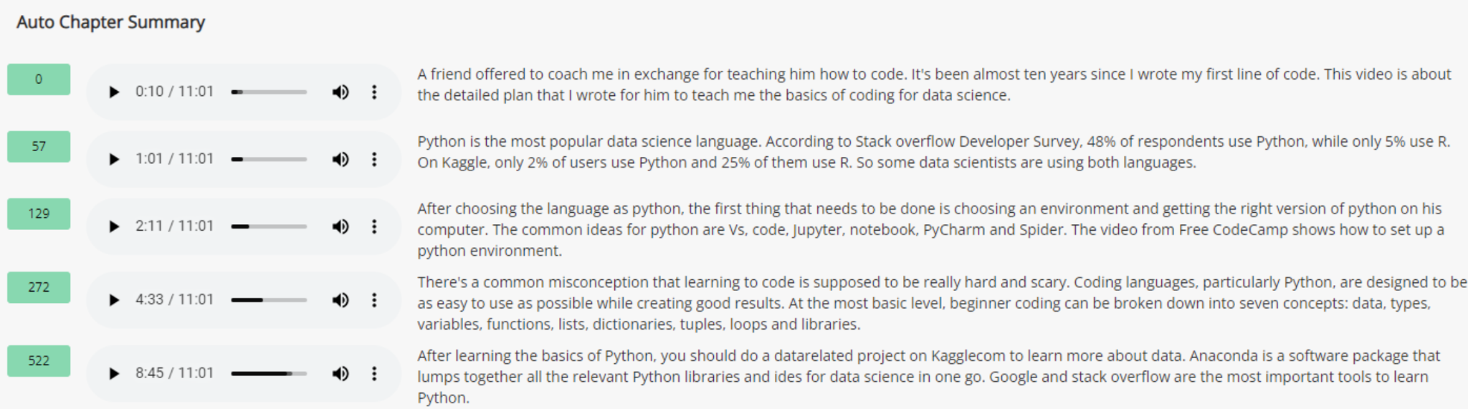
Video Summary in parts
Notes:
for example if you are watching a long video, our model will help to reduce it into a smaller parts as per the conversation flow, and gives a summaries of each part of the video.Here we can see that, That whole video is divided into 5 parts and we got short summary of those 5 parts. And This is how auto chapter summarization works

Slide 11
Accuracy stats
94%
Synopsis text analyzer accuracy
86%
Other Inbuilt Libraries

Slide 12
Tech Stack
Deep Learning
Assembly AI
Holo viz panel
Streamlit
Rest API
Django
j
Streamlit
Holo Viz panel
Rest API
Deep Learning

Slide 13

People Impact:
Our end users are students or anyone who is learning from youtube/online video tutorials
Our approach is more flexible compared to other traditional/manual approaches of summarizing video’s audio content

Slide 14

Ambition:
Our approach attacks a new problem: Video text summarization
It is difficult to stay focused on long length tutorials and take notes parallely
Many key points maybe missed because of being slack/human error

Slide 15
Innovation of Solution:
Our solution breaks new ground in auto text summarization and text analysis
Our solution fully automates the existing manual way of taking notes from a long length video tutorials

Slide 16
Extended Phase of our project

Slide 17
Smart Chat bot
If we think from a youtuber’s perspective he/she will find it hard to reply to all the comments made by the audience.
Hence we built a smart chatbot that can reply to the comments/questions asked by the audience
Our chatbot is in beta phase
Notes:
Our chatbot is still beta phase but you can see it in action in our demo video

Slide 18

Video demonstration of our project

Slide 19
Next phases
Auto reply chatbot integration to UI
Youtube comments analysis and auto replying for those questions in the comments, which saves youtuber’s and users time
Other applications
Call center auto AI reply based on the context of the question
Candidate filtering by AI video interviews
Crime interrogation audio content analysis
Notes:
Other applications of similar implementation

Slide 20




TEAM THAT MADE IT POSSIBLE
Vijay Agavinti
Anil Kochera
Naveen Tiragati
Kalyan Saiempu
A Computer Science graduate student at UMKC
If you are happy at your workplace every day is a great opportunity
A Computer Science graduate student at UMKC having passion to solve real world data problems
Computer Science masters student in UMKC

Slide 21

Our Application in Action

Slide 22
Thank you
Course: CS5560-001 - Knowledge Discovery Management
Instructor : Lee, Yugyung
Organizers of Hack-A-Roo

Slide 23
References:
https://dl.acm.org/doi/10.1145/2959100.2959190
https://vidiq.com/blog/post/5-youtube-algorithm-myths-youtubers-need-to-know-about/
https://arxiv.org/pdf/1912.08777.pdf
https://towardsdatascience.com/pegasus-google-state-of-the-art-abstractive-summarization-model-627b1bbbc5ce
https://www.assemblyai.com/docs/audio-intelligence#auto-chapters

